Slide 1
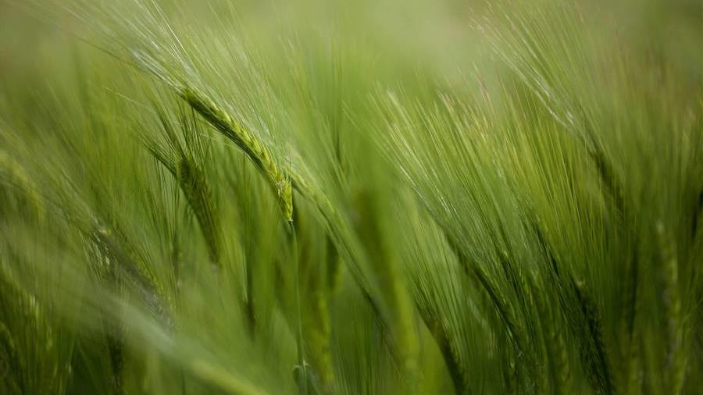
Analytics Case study
Coral Baas​​

Slide 2
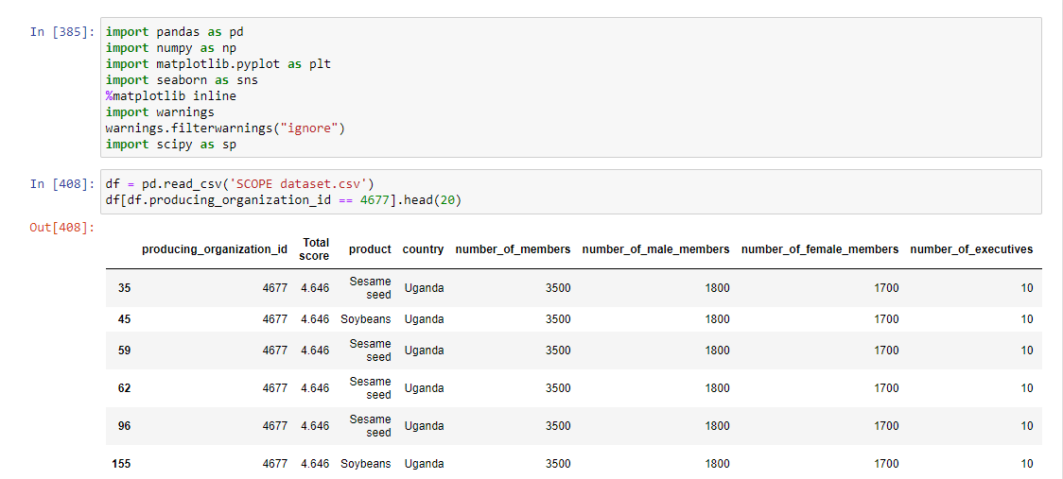
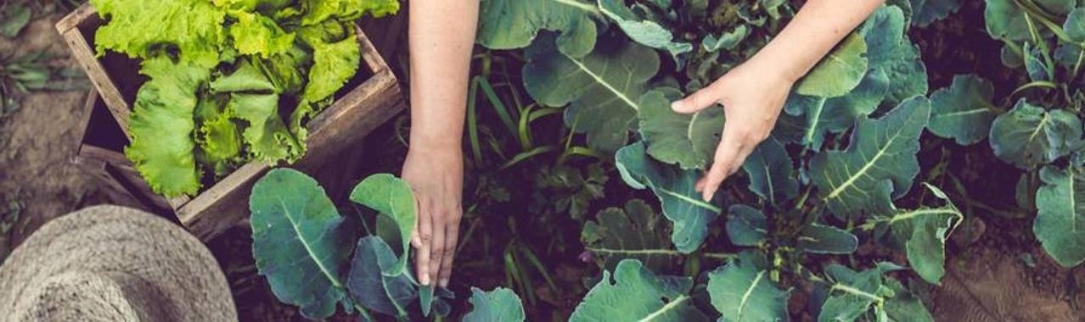
1. Identify top 3 male and female-led performance
Read the file in Python (jupyter notebook) with pandas.
Overview of the data base (4704 rows x 12 columns)
Duplicate rows (id 4677 has 96 rows)
More than one product per id
Each product was evaluated (sub-dimensions SCOPEinsight)

Slide 3
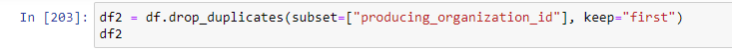
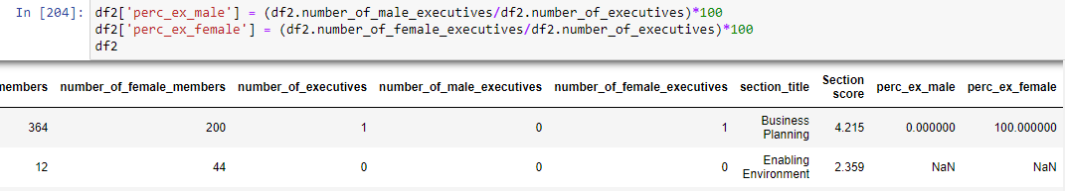
coding
1 drop duplicates
2 Create two columns

Slide 4
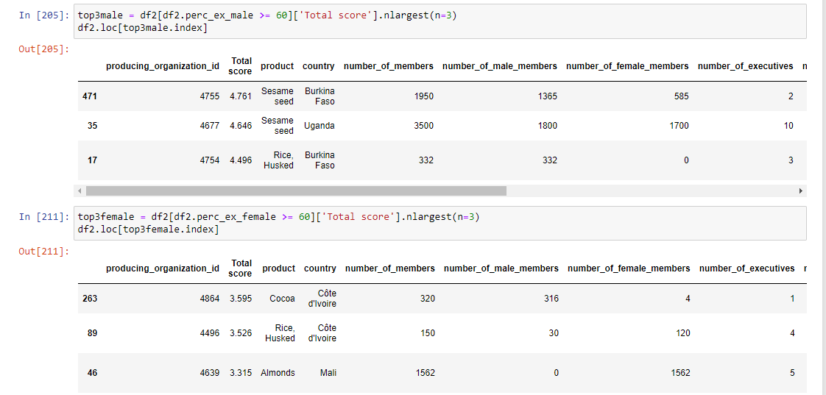

3 create two data frames

Slide 5
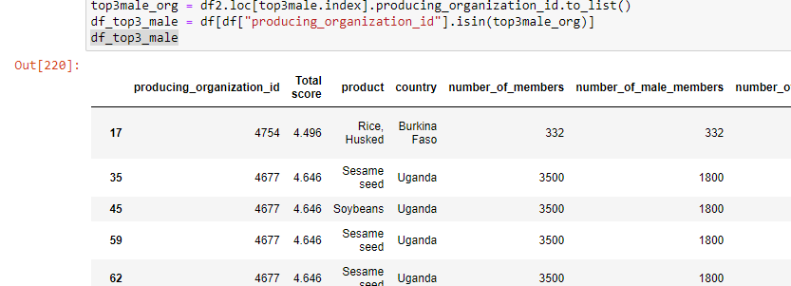
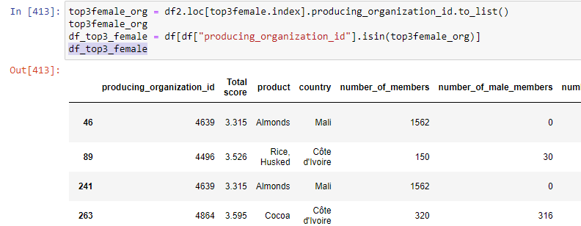
4 retrieve values of the column products - two new DF

Slide 6
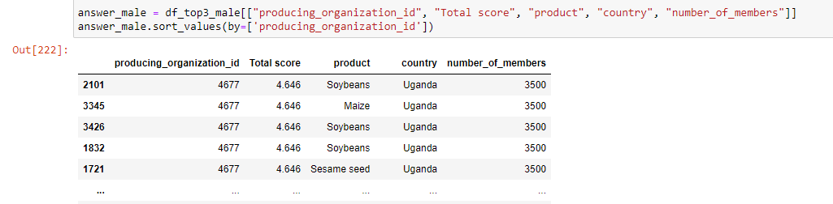
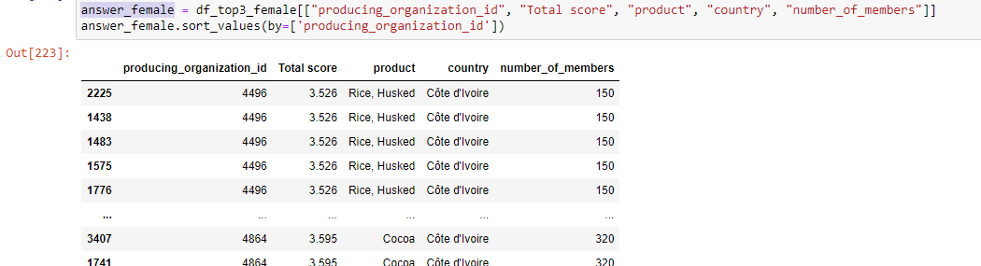
First result

Slide 7
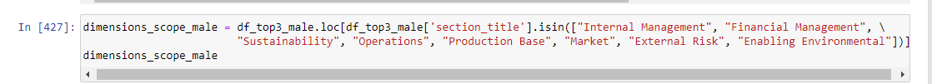
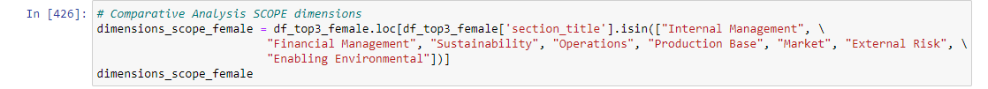
2. Comparative analysis based on scopeinsight dimensions
Recover the duplicates (df original)
Previous result convert in lists
Create two new data frames filtering the 8 dimensions SCOPEinsight
Visualize (sns.barplot)

Slide 8
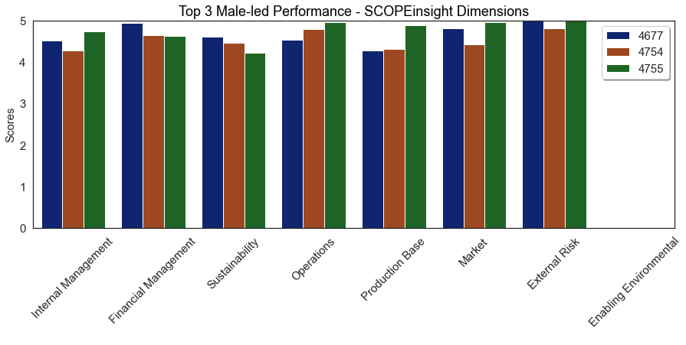
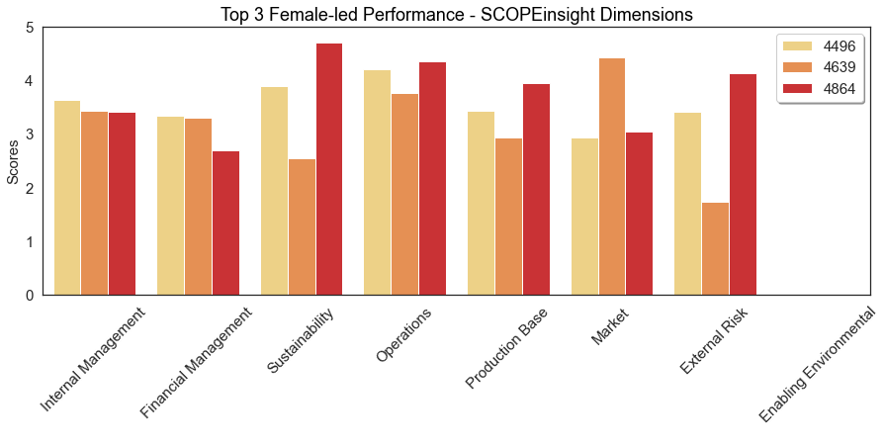

Slide 10
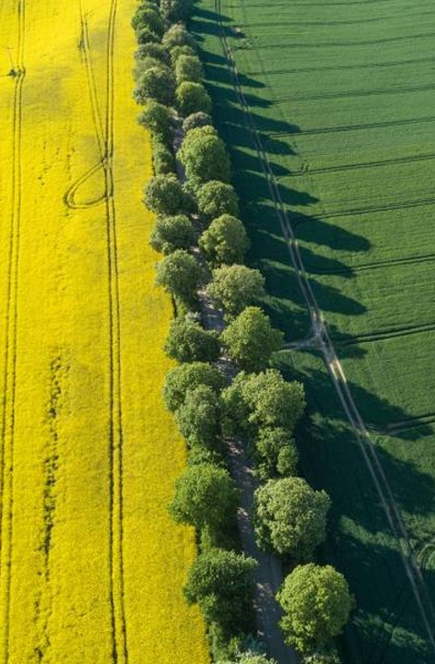
solution
Close the gap
Target audience
Our product makes organic farming easier, and no other product on the market offers the same benefits or yield.
Gen Z (18-25 years old)
Cost savings
Easy to use
Reduce expenses for replacement products
A simple product that gives customers the information they need in order to produce an abundance of rich produce

Slide 11




Product overview
Unique
First to market
Tested
Authentic
Only product specifically dedicated to the agricultural market
First beautifully designed product that's both stylish and functional
Conducted testing with young farmers in the area
Designed with the help and input of agricultural experts in the field

Slide 12
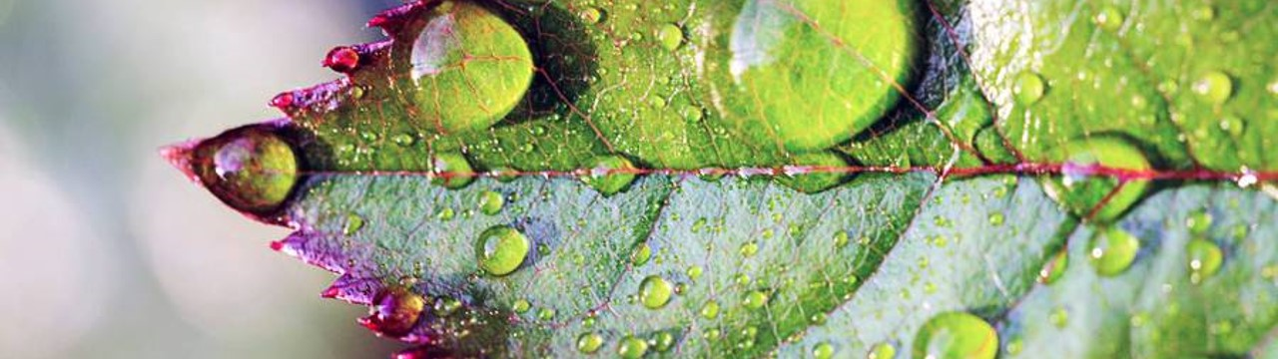
Product Benefits
Cool and stylish product​
Areas for community connections ​
Online store and market swap

Slide 13
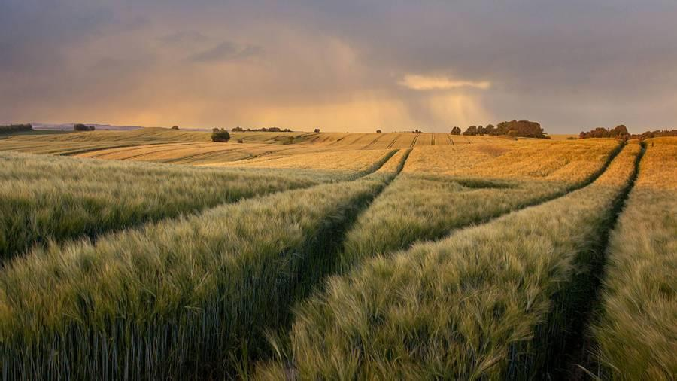
Company Overview

Slide 14

Business model
research
We based our research on market trends and social media​
abstract
We believe people need more products specifically dedicated to this niche market​
design
Minimalist and easy to use ​

Slide 15
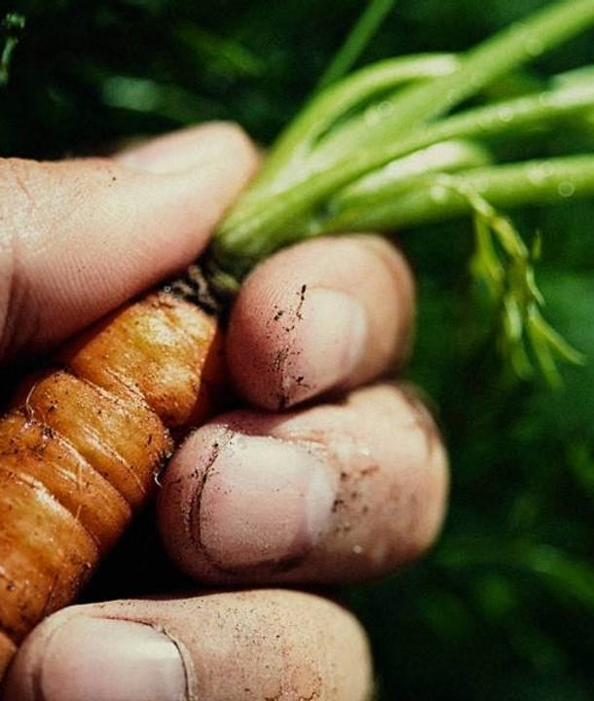
Market overview
Opportunity to build​
Fully inclusive market
Total addressable market​
$3B​
Freedom to invent​
Selectively inclusive market​
Serviceable available market​
$2B
Few competitors​
Specifically targeted market​
Serviceable obtainable market​
$1B

Slide 16
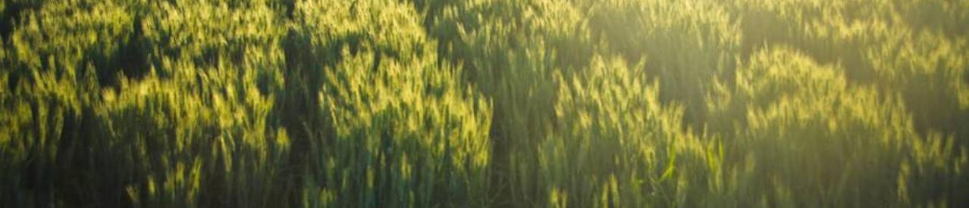
Market comparison
$3b
$2b
$1B
Opportunity to build
Freedom to invent
Few competitors
Addressable market​
Serviceable market​
Obtainable market​

Slide 17
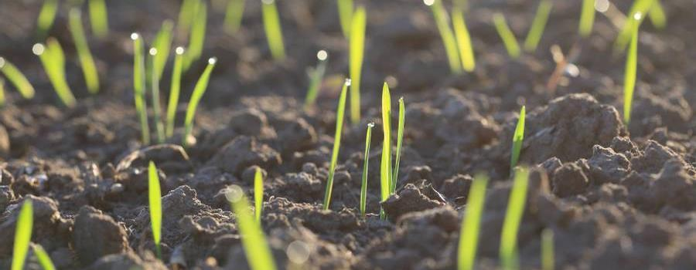
Our competition
contoso
Competitors
Our product is priced below that of other companies on the market​
Design is simple and easy to use, compared to the complex designs of the competitors​
Affordability is the main draw for our consumers to our product​
Company A​ Product is more expensive​
Companies B & C ​ Product is expensive and inconvenient to use​
Companies D & E​ Product is affordable, but inconvenient to use

Slide 18
Competitive layout
convenient
contoso
A
Expensive​
affordable
B
D
C
E
Inconvenient​

Slide 19

Growth strategy
How we’ll scale in the future​
Feb 20xx
Roll out product to local farms in the region to help establish the product​
May 20xx
Release the product to the general public and monitor press and regional market trends​
Oct 20xx
Gather feedback from the agriculture and farming community to expand availability of the product​

Slide 20
Traction
Forecasting for success​
Metrics
Revenue by year
 | clients | orders | Gross avenue | Net revenue
20XX​ | 10​ | 1,100​ | $10,000​ | $7,000​
20XX​ | 20​ | 200​ | $20,000​ | $16,000​
20XX​ | 30​ | 300​ | $30,000​ | $25,000​
20XX​ | 40​ | 400​ | $40,000​ | $30,000​

Slide 21
2-year action plan
Get volunteers​
Gather feedback​
Deliver to consumers​
20XX
Jan
Feb
Mar
Apr
May
Jun
Jul
Aug
Sep
Oct
Nov
Dec
Run focus groups​
Test with farms​
Regional launch​
20XX
Jan
Feb
Mar
Apr
May
Jun
Jul
Aug
Sep
Oct
Nov
Dec

Slide 22
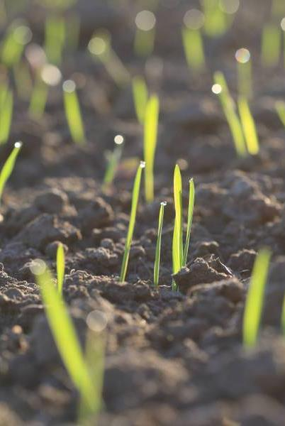
financials
 | Year 1 | Year 2 | year 3
Detailers​ | 5,000​ | 40,000​ | 160,000​ | ​
Users​ | 50,000​ | 400,000​ | 1,600,000​ | ​
Sales​ | 500,000​ | 4,000,000​ | 16,000,000​ | ​
Average Price per Sale​ | 75​ | 80​ | 90​ | ​
Revenue @ 15%​ | 5,625,000​ | 48,000,000​ | 216,000,000​ | ​
Gross Profit​ | 5,625,000​ | 48,000,000​ | 216,000,000​ | ​
Expenses​ | ​ | ​ | ​ | ​
Sales & Marketing​ | 5,062,500​ | 38,400,000​ | 151,200,000​ | ​
Customer Service​ | 1,687,500​ | 9,600,000​ | 21,600,000​ | 70%​
Product Development​ | 562,500​ | 2,400,000​ | 10,800,000​ | 10%​
Research​ | 281,250​ | 2,400,000​ | 4,320,000​ | 5%​
Total Expenses​ | 7,593,750​ | 52,800,000​ | 187,920,000​ | 2%​
EBIT | -1,968,750 | -4,800,000 | 28,080,000 | ​

Slide 23
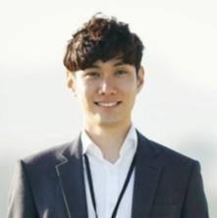
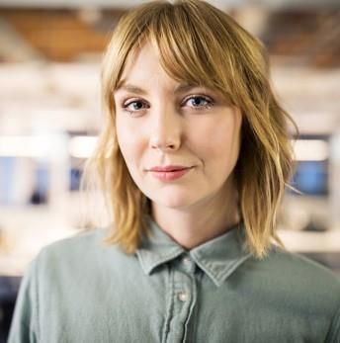
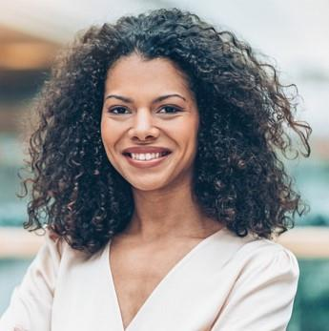

Meet the team
Takuma Hayashi​​
Mirjam Nilsson​​
Flora Berggren​​
Rajesh Santoshi​​
President
Chief Executive Officer​
Chief Operations Officer​
VP Marketing​

Slide 24

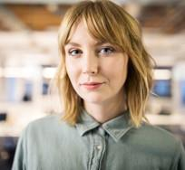
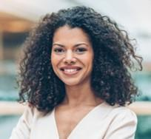

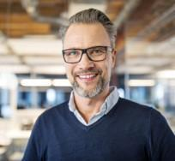
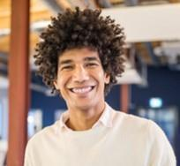


Meet the team
Takuma Hayashi​
Mirjam Nilsson​
Flora Berggren​
Rajesh Santoshi​
President
Chief Executive Officer
Chief Operations Officer
VP Marketing
Graham Barnes
Rowan Murphy
Elizabeth Moore
Robin Kline
VP Product
SEO Strategist
Product Designer
Content Developer

Slide 25
Funding
12K
32K
14K
82K
Campaigns​
Angel investments​
Cash
Shares
Revenue obtained from online campaigns and door-to-door sales​
Amount obtained through other investors
Liquid cash we
have on hand
Number of shares converted into USD

Slide 26
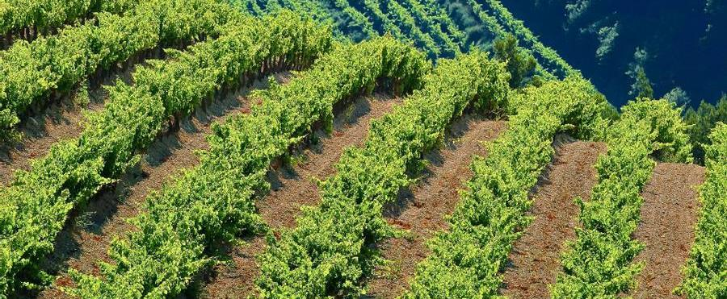
summary
At Contoso, we believe in giving 110%. By using ethical farming methods, we help farming communities grow organically and foster a consumer first mindset. We thrive because of our market knowledge and a great team behind our product. As our CEO says, "Efficiencies will come from proactively transforming how we do business."

Slide 27
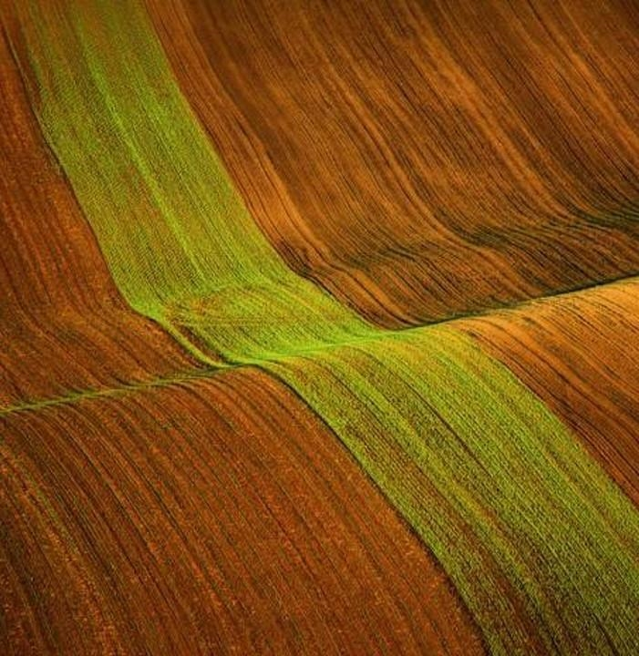
Thank you
Mirjam Nilsson​​
206-555-0146​
mirjam@contoso.com​
www.contoso.com​

